Slide 1


Slide 2


Slide 3
Directors
By Simran Chawla Mam

Slide 4


Slide 5
Group name
Roma Deshmukh
Ritu Thakur
Rajeshwari
Ravina
Ranjita
Ranjana
Roshni
Roshni Sahu
Roshni Aanat
Ritesh Achhara
Romish Verma
Ritesh Prajapati
Ravikant Patel
Sagar Sahu
Sagar Turkane

Slide 6


Slide 7
Director Meaning
A director is a person elected or appointed by the shareholders to control, manage, and direct the company's affairs and policies. Directors, as a collective body known as the Board of Directors, act as trustees of the company's property and money, holding fiduciary duties to act in the best interests of the company and its shareholders. They make high-level decisions on strategy, finances, and management, ensuring compliance with laws and regulations

Slide 8


Slide 9
Appointment of Director
The appointment of a director involves obtaining a Director Identification Number (DIN) and Digital Signature Certificate (DSC) for the proposed director, securing their consent and disclosures (Form DIR-2), and passing a resolution at a board or general meeting. Finally, the company must file the appointment details with the Registrar of Companies (ROC) .using Form DIR-12 within 30 days.

Slide 10
Pre Appointment requirement
Review AOA: Check the company's Articles of Association (AOA) to confirm the appointment procedure.
Check eligibility: Ensure the individual is over 18 and not disqualified under the Companies Act, 2013.
Obtain DIN and DSC: The prospective director must obtain a DIN and a DSC. If they already have them, they don't need to apply again

Slide 11
Company Procedure
Board Meeting: Convene a board meeting to pass a resolution to appoint the director.
Issue appointment letter: Send a formal Letter of Appointment to the director.
Obtain consent: The new director must provide their written consent via Form DIR-2.
Submit disclosures: The director must also provide disclosures, such as Form DIR-8.

Slide 12
Post Appointment filing
File with ROC: The company must file Form DIR-12 with the ROC within 30 days of the appointment.
Update company records: Inform relevant regulatory authorities, such as the GST Network (GSTN), of the change.

Slide 13
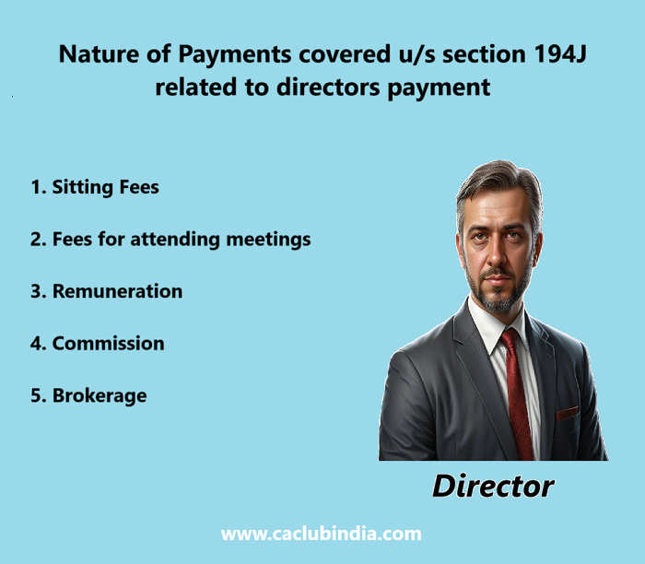

Slide 14
Director Remunaration
A director's remuneration is compensation for their services, such as sitting fees, salaries, and profit commissions, while their duties include acting in good faith, promoting the company's success, exercising due care and skill, and avoiding conflicts of interest. Remuneration is approved by the board of directors and shareholders and is often subject to statutory limits, while duties are a legal and fiduciary obligation to the company.

Slide 15
Remuneration of Directors
Types: Can include sitting fees for meetings, salaries, allowances, perquisites, and commission (e.g., a percentage of profits).
Structure: Determined by the board of directors and approved by shareholders, often with guidance from a Nomination and Remuneration Committee.
Limits: In many jurisdictions, there are limits on the total remuneration payable to directors, such as a cap based on the company's net profits.
Payment: Paid through various methods, such as a fixed salary, a commission, or a combination, and is subject to taxes.
Other forms: Can also include benefits like medical reimbursement or an Employee Stock Ownership Plan (ESOP)

Slide 16
Duties of Directors
Act in good faith: Directors must act in the best interests of the company and its shareholders.
Exercise reasonable care, skill, and diligence: This means they must perform their duties with the same level of care that a reasonably prudent person would use in similar circumstances.
Exercise independent judgment: Directors must make their own decisions, free from undue influence from others.
Avoid conflicts of interest: Directors cannot put their personal interests ahead of the company's interests.
Not accept benefits from third parties: Directors must not accept benefits from third parties that could influence their decision-making on behalf of the company.
Promote the success of the company: Directors have a duty to act in a way that is most likely to promote the success of the company for the benefit of its members as a whole.

Slide 17


Slide 18
Managing Director
A managing director (MD) is a senior executive responsible for the day-to-day operations and management of a company or a specific business unit, reporting to the board of directors. They are tasked with implementing the company's vision, managing daily operations, and ensuring the company's financial performance and strategic goals are met. The role involves overseeing departments, managing budgets, developing strategies, and maintaining relationships with key stakeholders.

Slide 19
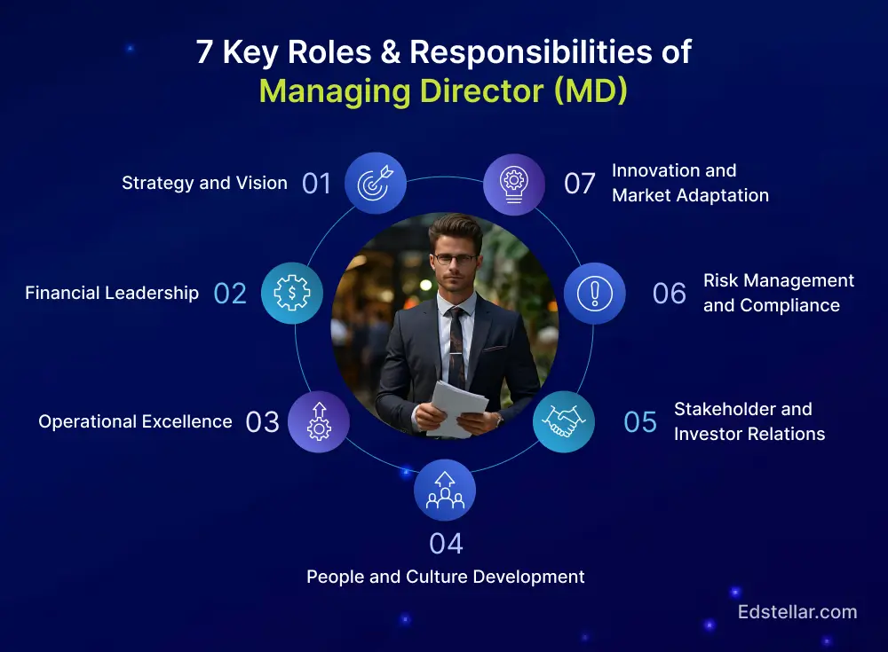

Slide 20
Key Responsiblities Of Managing Director
Operational oversight: Manage the company's daily operations and oversee the performance of different departments.
Strategic implementation: Implement the overall strategy and vision set by the board of directors, and report on overall performance.
Financial management: Develop and manage budget plans, track performance, and aim to maximize revenue and minimize costs.
Stakeholder management: Build and maintain relationships with customers, suppliers, investors, and other key contacts.
Leadership: Create a positive work environment and guide teams to achieve company objectives.

Slide 21
Key Role Of Managing Director
CEO: In some countries, the terms "CEO" and "managing director" are used interchangeably for the top executive. In others, the CEO may focus more on long-term vision, while the MD is more involved in day-to-day operations.
Board of Directors: The MD reports to the board and is responsible for implementing their decisions and directives across all departments.
Department heads: The MD receives reports from department managers and works with them to ensure the company runs efficiently.

Slide 22


Slide 23
Women Director
A "women director" can refer to a woman who directs a film or a woman appointed to the board of a company. In a corporate context, certain companies are legally required to have a woman director, and the rules involve specific criteria for appointment and penalties for non-compliance. In the film industry, women have directed many notable films, and their work is often recognized and celebrated.

Slide 24
Role of women director
In a corporate context
Mandatory requirement: Under the Companies Act, 2013 every listed company and certain public companies with a paid-up capital of ₹100crore or more or a turnover of ₹300crore or more must have at least one woman director on its board.
Appointment process: A woman director is appointed by a board resolution and requires shareholder approval at a general meeting. The company must then file Form DIR-12 with the Registrar of Companies (ROC) within 30 days.
Vacancy: If a woman director's position becomes vacant, the board must fill the vacancy within three months

Slide 25
In the film industry
Notable directors: Women have made significant contributions to filmmaking. Some well-known examples include Sofia Coppola, known for films like Lost in Translation, and Kathryn Bigelow.
Early recognition: Marleen Gorris directed Antonia's Line in 1995, which was the first time the Academy Award for Best Foreign Language Film was awarded to a female film director.
Diversity: Many women directors are making diverse films across different genres. Other examples include Amy Heckerling and Justine Triet.

Slide 26



Slide 27
Wholetime Director
A whole-time director is a director in the full-time employment of a company, responsible for its day-to-day management and administration, and entitled to remuneration. Unlike independent directors, they are part of the company's senior management and have significant decision-making authority, meaning they are not just part-time board members. A person appointed as a director can be considered a whole-time director if they are in the company's full-time employment.

Slide 28
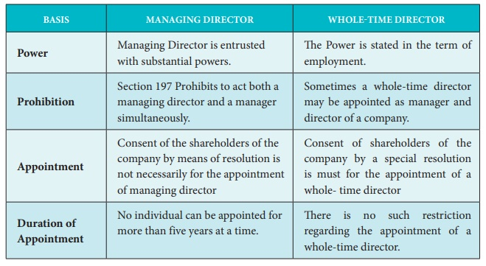

Slide 29
Key Aspect of Wholetime Director
Full-time commitment: They are employees who devote all their time and attention to the company's affairs.
Remuneration: They receive a salary and other benefits, such as bonuses or stock options.
Management role: They are actively involved in the daily operations and management of the company.
Decision-making: They hold significant decision-making authority, unlike a regular or independent director.
Employee status: A full-time employee appointed as a director automatically becomes a whole-time director.
Key Managerial Personnel (KMP): Under laws like the Companies Act, 2013, a whole-time director is considered a Key Managerial Personnel.
Appointment: They are appointed by the board of directors and must be a director of the company before taking on the whole-time director role.
Term: The term for their appointment is typically for a maximum of five years at a time.

Slide 30



Slide 31
Conclusion
Directors are vital to a company's governance, legally responsible for guiding its strategic direction and protecting stakeholder interests with a duty of care, skill, and diligence. Their role is complex, as they act as agents, fiduciaries, and stewards of the company's assets, and must act in good faith to ensure the company's long-term success. A key conclusion is that while directors have substantial power, their authority is balanced by a wide range of legal obligations and potential penalties for negligence or misconduct, emphasizing the importance of ethical and compliant leadership

Slide 32


